Slide 1
Module, meet Blockchain
Nik Kalyani

Slide 2











Please support our valuable sponsors

Slide 3

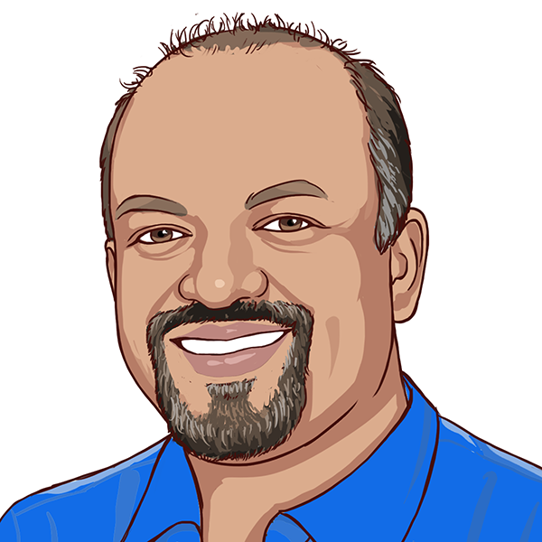




Nik Kalyani
Co-founder/CTO

Slide 4


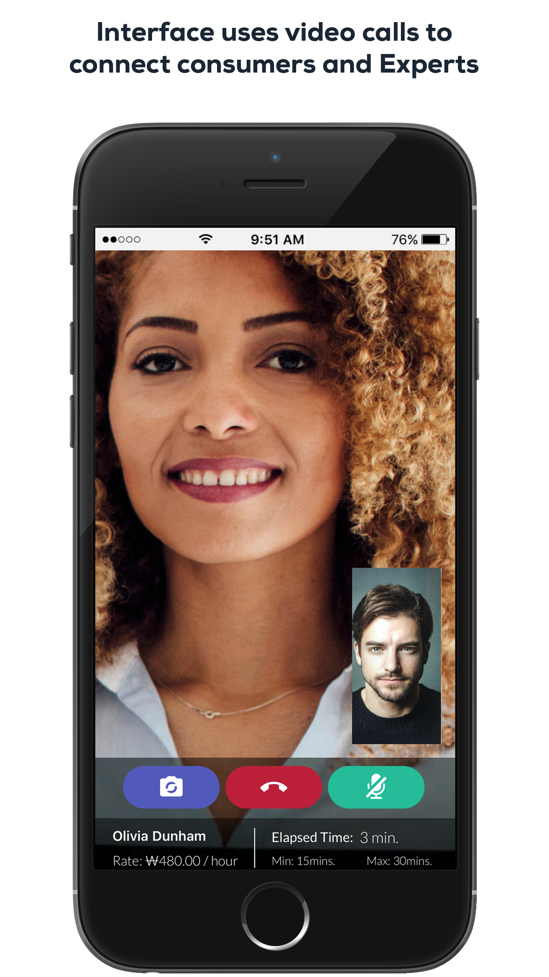

WhenHub
40,000
downloads
interface.whenhub.com

Slide 5
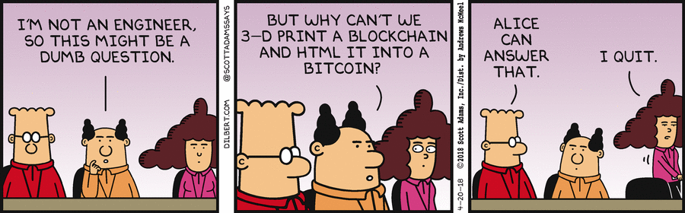

Slide 6
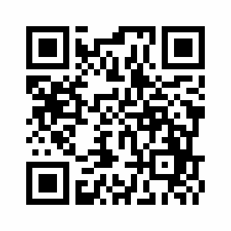
Code and Presentation
https://tinyurl.com/dnnconnect-2018
@techbubble
#DNNConnect2018
#SmartContracts

Slide 7
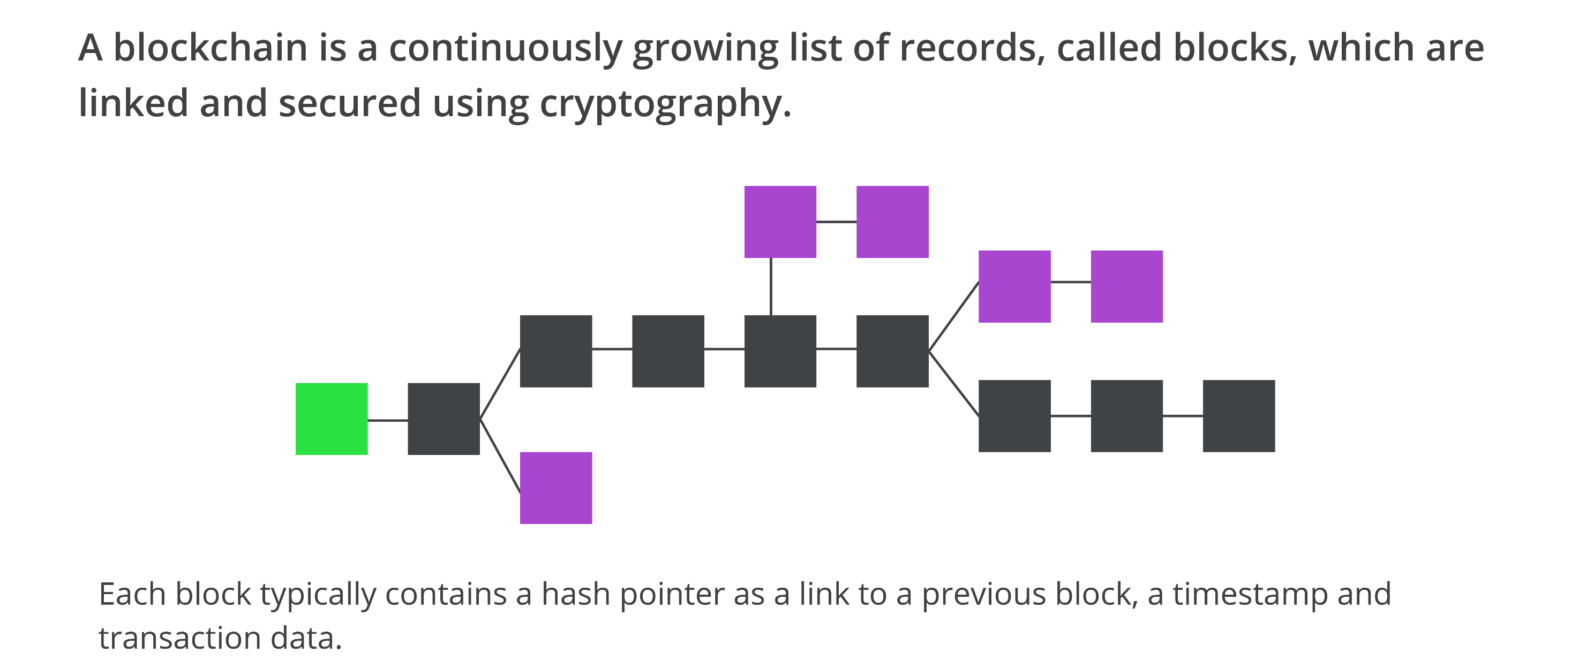
Blockchain

Slide 8
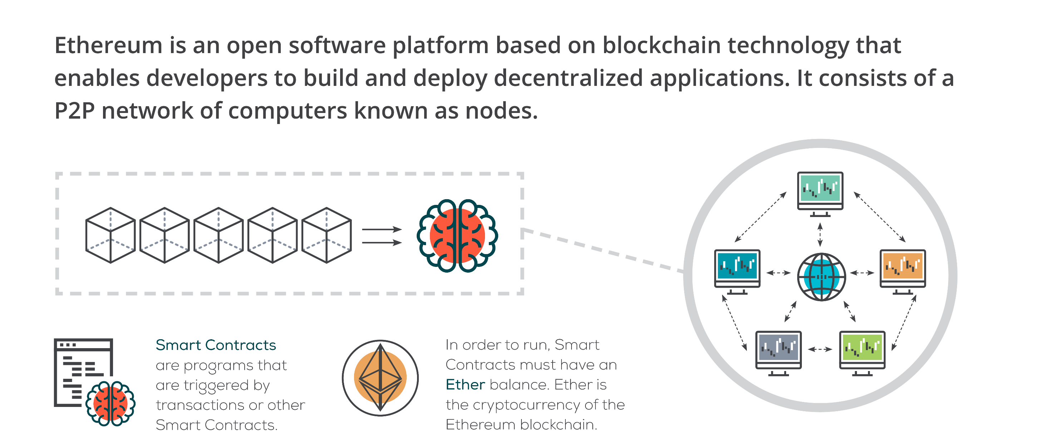
Ethereum

